Slide 1




Seoul, Korea · 2026
iVGR: Internalizing Visually Grounded Reasoning
for MLLMs with Reinforcement Learning
Chang-Bin Zhang¹ Yujie Zhong² Qiang Zhang³ Kai Han^{1*}
¹ Visual AI Lab, The University of Hong Kong ² Independent Researcher ³ University of Science and Technology of China
Project page visual-ai.github.io/ivgr

Slide 2
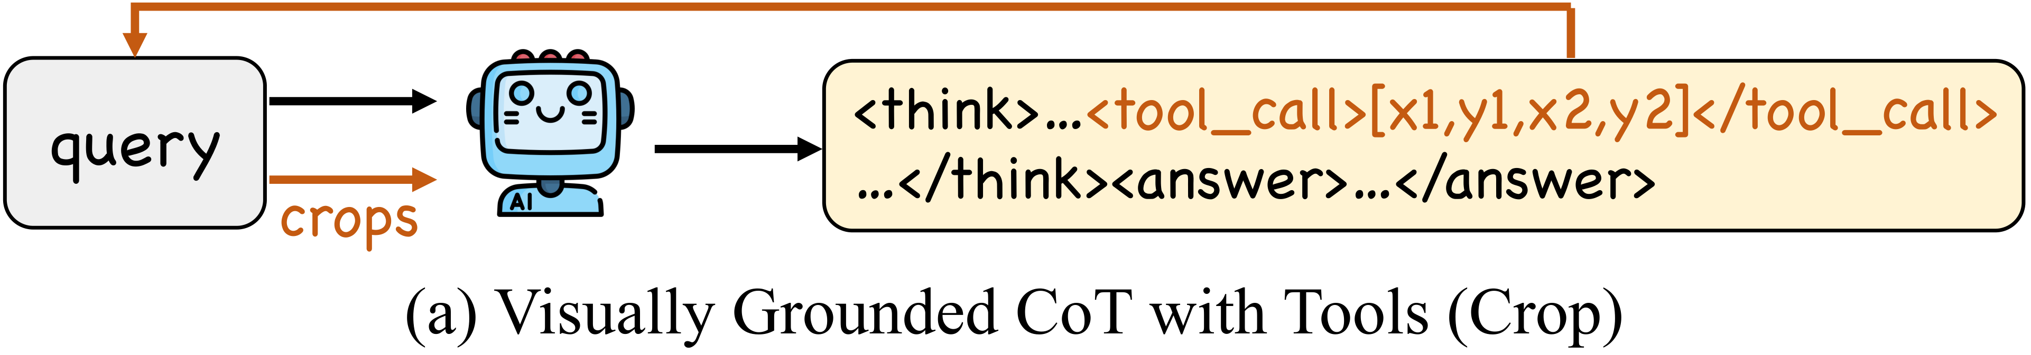
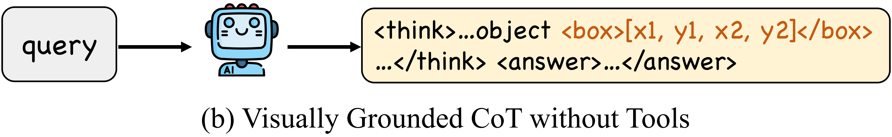
Background & Task
Fine-grained VQA
Answer questions on high-resolution images where the answer hinges on small, easily-missed regions.
The Challenge
• MLLMs miss critical details in high-res scenes.
• Plain textual CoT often “looks” at the wrong place.
• → motivates visually grounded reasoning.
Existing paradigms: Visually Grounded CoT
iVGR · ICML 2026
2

Slide 3
Two paradigms in visually grounded reasoning
1
Crop tools
“think with images”
Visual CoT
o3
Pixel Reasoner
DeepEyes
Thyme
Mini-o3
DeepEyesV2
NeurIPS ’24
OpenAI
NeurIPS ’25
ICLR ’26
ICLR ’26
ICLR ’26
ICLR ’26
Mar ’24
Apr ’25
May ’25
May ’25
Aug ’25
Sep ’25
Nov ’25
2
Explicit boxes
boxes interleaved in the CoT
GRIT
VGR
TreeVGR
Think with
Visual Primitives
NeurIPS ’25
ICLR ’26
ICLR ’26
DeepSeek
May ’25
Jun ’25
Jul ’25
May ’26
iVGR · ICML 2026
2

Slide 4
Our finding
Prompt off-the-shelf grounded-CoT models to reason in plain text — they beat their own grounded CoT, without any retraining.
Benchmark | Qwen2.5-VL-7B | DeepEyes-7B |  | TreeVGR-7B
CoT | Textual | Grounded | Textual | Grounded | Textual
V* | 78.5 | 82.7 | 81.7 | 83.8 | 84.3
HR4K | 69.0 | 75.1 | 74.9 | 77.1 | 76.9
HR8K | 65.1 | 72.6 | 73.1 | 73.1 | 74.7
MME-RW-Lite | 44.5 | 53.2 | 53.5 | 54.9 | 54.7
POPE | 86.3 | 87.7 | 89.2 | 87.3 | 88.4
RealWorldQA | 68.1 | 69.4 | 69.7 | 67.3 | 69.5
CV-Bench-2D | 75.7 | 75.0 | 77.9 | 76.6 | 77.7
CV-Bench-3D | 73.6 | 77.3 | 80.8 | 77.2 | 79.3
Avg. | 70.1 | 74.1 | 75.1 | 74.7 | 75.7
Textual CoT (no grounding) wins on most benchmarks, without any retraining.
iVGR · ICML 2026
3

Slide 5
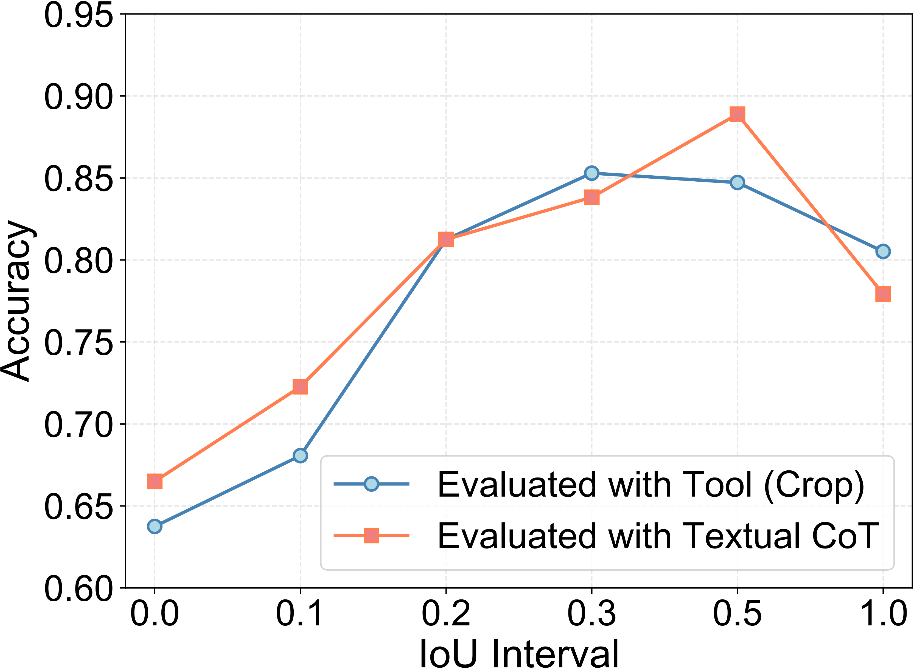
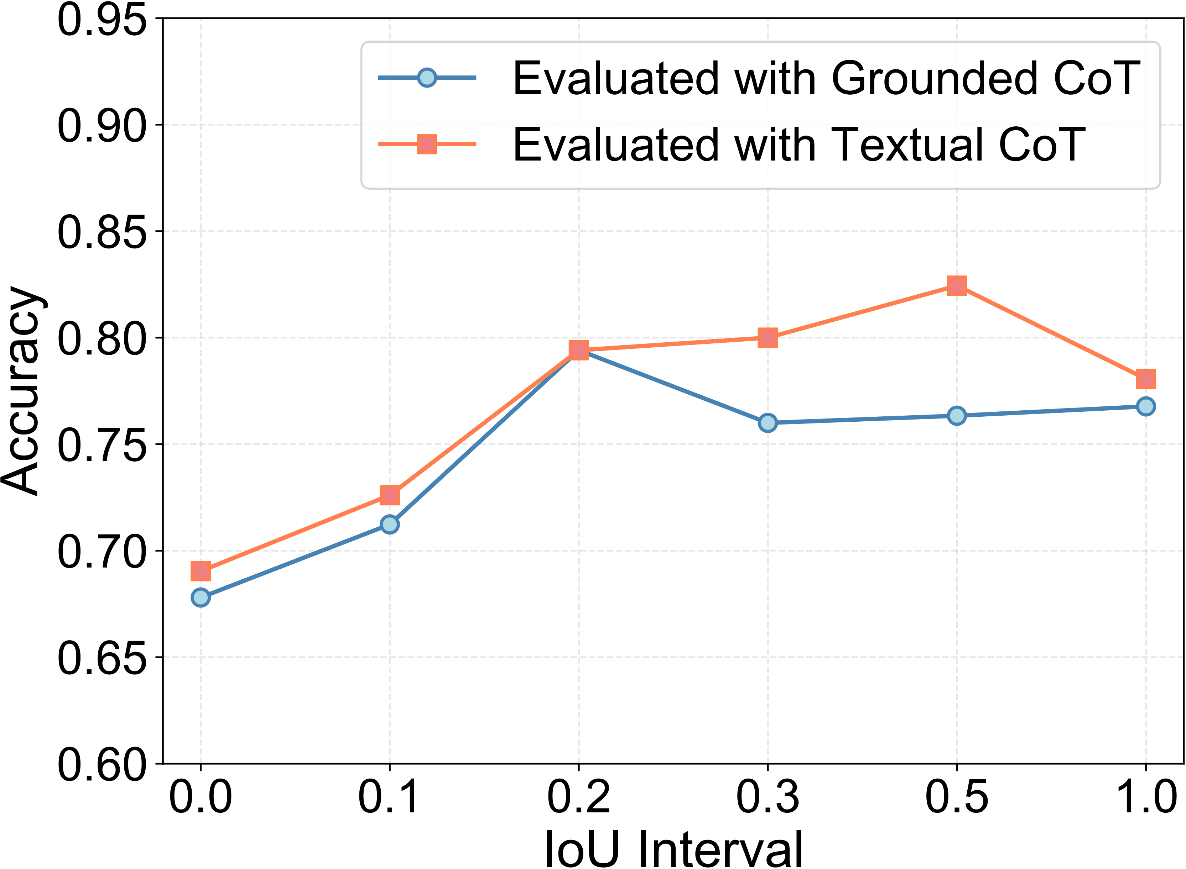
Why? Accuracy vs. grounding quality
DeepEyes (crops)
TreeVGR (boxes)
Accuracy vs. IoU of the grounded CoT (HR8K).
• DeepEyes (crops): wins only when crops are accurate (IoU > 0.5); bad crops add noise.
• TreeVGR (boxes): grounded CoT loses across all IoU intervals.
Localization can be internalized into textual reasoning. → Internalize in training; perform reasoning in pure text at inference.
iVGR · ICML 2026
4

Slide 6
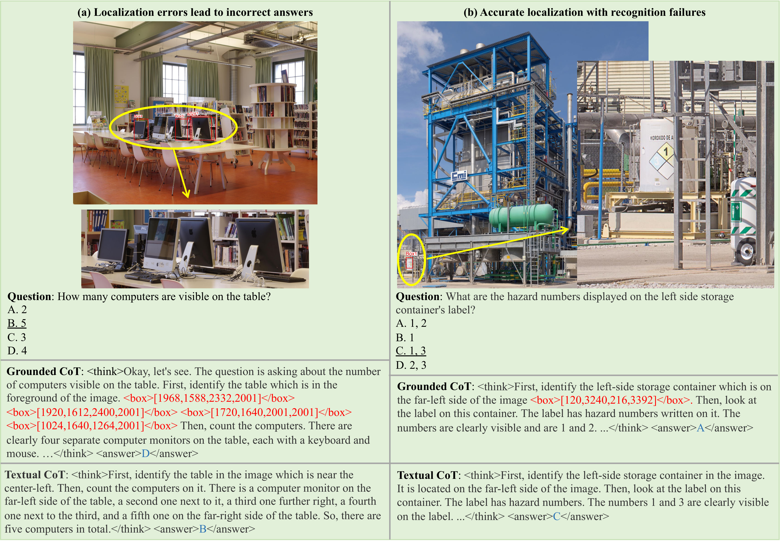
Two failure modes of grounded CoT at inference
iVGR · ICML 2026
5

Slide 7
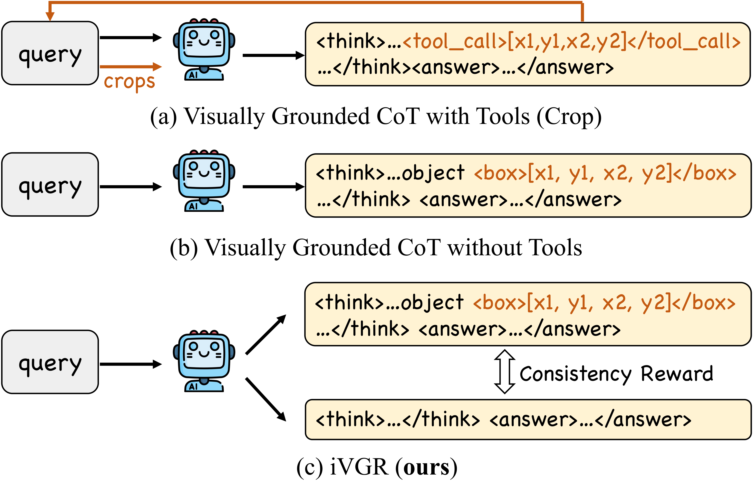
A third paradigm: iVGR (ours)
Dual-stream Alignment by a consistency reward → pure-text reasoning at inference
iVGR · ICML 2026
6

Slide 8






















iVGR: dual-stream RL with a consistency reward
The reasoning process and answer are enclosed within <think> </think> and <answer> </answer> tags, respectively. When referring to particular objects in the reasoning process, the assistant MUST localize the object with bounding box coordinates between <box> and </box> (e.g., <box>[x1,y1,x2,y2]</box>).
Grounded
Stream
Reference Model
Format Reward
Accuracy Reward
Group
Normalize
…
…
…
Reward Function
Box Reward
Select Rollout
Rollout Archive
format reward = 1 ?
acc reward = 1 ?
box reward > 𝜏 ?
update
1
<think>…<box>[x1, y1, x2, y2]</box>…</think>
Prompt of Grounded CoT
2
<think>…obj<box>[x1,y1,x2,y2]</box>…</think>
query
Policy
…
……
MLLM
<think>…</think>
<answer>…</answer>
<think>…<box>[x1, y1, x2, y2]</box>
<answer>…</answer>
Prompt of Textual CoT
Reference CoT
The reasoning process and answer are enclosed within <think> </think> and <answer> </answer> tags, respectively, i.e., <think> reasoning process here </think> <answer> answer here </answer>.
LLM Judge
Reward Function
Consistency Reward
Accuracy Reward
Group
Normalize
Textual
Stream
…
…
…
Reference Model
Format
Reward
Step 1 Each query is rolled out by the policy MLLM.
Step 2 Grounded stream: roll out CoTs with boxes; reward format, accuracy, and box-IoU.
Step 3 Textual stream: roll out plain-text CoTs; reward format and accuracy.
Step 4 Keep valid, accurate, well-localized grounded CoTs; archive the best per query.
Step 5 An LLM judge scores the textual CoT vs. the archived grounded reference → consistency reward.
Step 6 Group-normalize the rewards into advantages (GRPO) and update the policy.
iVGR · ICML 2026
7

Slide 9
Two streams, two reward recipes
Grounded stream
Textual stream
Localize every mentioned object:
<box>[x1,y1,x2,y2]</box>
Plain-text reasoning — no coordinates;
used at inference time.
Format
+
Accuracy
+
Box IoU
Format
+
Accuracy
+
Consistency
novel — transfers grounding into text
Learn to look at the right place without explicit coordinates.
iVGR · ICML 2026
8

Slide 10
Consistency reward: the core novelty
1
Reference selection: keep grounded rollouts with valid format · correct answer · R_{box} > τ = 0.3.
2
Rollout archive: persist the best grounded CoT per query across steps (hit rate → ~50%).
3
LLM judge (Qwen2.5-72B): does the textual CoT describe the same visual content as the grounded reference?
1.0
identical visual content
0.7
omits OR adds details
0.3
omits AND adds details
0.0
contradicts reference
iVGR · ICML 2026
9

Slide 11
Training data: cold-start + RL
1
Cold-start (SFT)
35K
2
RL (GRPO)
51K
TreeVGR-SFT-35K
with target boxes · TreeVGR-RL-37K
32K
grounded CoT
original box annotations
32K
V*
high-resolution scenes
5K
VisDrone
drone imagery · small objects
3K
textual CoT
synthesized by Qwen2.5-VL-72B
no boxes · general reasoning · 14K
12K
OpenMMReasoner
ViRL · DocVQA · We-Math · …
2K
ArxivQA
figure / chart QA
Two-stage training: cold-start SFT (35K) → GRPO RL (51K = 37K boxed + 14K general).
iVGR · ICML 2026
11

Slide 12
Results: SOTA without boxes
Models | Tools | Fine-grained VQA |  |  | General VQA |  |  |  |  | Avg.
 |  | V* | HR4K | HR8K | MME RW-Lite | POPE | Real WorldQA | CV-2D | CV-3D
Proprietary Models
Gemini-3.1-Pro-Preview | – | 87.4 | 88.9 | 88.1 | 55.8 | 88.0 | 83.5 | 85.0 | 94.6 | 83.9
GPT-5.4 | – | 88.0 | 87.4 | 80.6 | 63.4 | 87.9 | 83.0 | 82.4 | 91.9 | 83.1
Visually Grounded Reasoning Models
GRIT-3B | ✗ | 54.5 | 48.4 | 43.5 | 33.8 | 80.8 | 58.0 | 72.5 | 68.2 | 57.5
PixelReasoner-7B | ✓ | – | 72.9 | 66.9 | 49.7 | – | – | – | – | –
DeepEyes-7B | ✓ | 82.7 | 75.1 | 72.6 | 53.2 | 87.7 | 69.4 | 75.0 | 77.3 | 74.1
DeepEyesV2-7B | ✓ | 81.8 | 77.9 | 73.8 | – | – | – | – | – | –
Mini-o3-7B | ✓ | – | 77.5 | 73.3 | – | – | – | – | – | –
Thyme-7B | ✓ | 82.2 | 77.0 | 72.0 | 55.2 | 86.8 | 70.2 | 78.0 | 75.1 | 74.6
TreeVGR-7B | ✗ | 83.8 | 77.1 | 73.1 | 54.9 | 87.3 | 67.3 | 76.6 | 77.2 | 74.7
iVGR-Qwen2.5-VL-7B (ours) | ✗ | 86.4 | 78.3 | 75.5 | 55.6 | 88.9 | 68.6 | 78.4 | 81.1 | 76.6
Δ v.s. Qwen2.5-VL-7B |  | +7.9 | +9.3 | +10.4 | +11.1 | +2.6 | +0.5 | +2.7 | +7.5 | +6.5
iVGR-Qwen3-VL-8B (ours) | ✗ | 90.1 | 82.0 | 80.1 | 60.7 | 89.4 | 71.0 | 80.8 | 91.0 | 80.6
Δ v.s. Qwen3-VL-8B |  | +7.4 | +5.5 | +9.7 | +11.7 | +1.3 | +0.5 | +2.2 | -2.5 | +4.4
iVGR-Qwen3-VL-32B (ours) | ✗ | 93.2 | 82.9 | 82.9 | 61.2 | 88.8 | 76.3 | 83.9 | 93.8 | 82.9
Δ v.s. Qwen3-VL-32B |  | +9.4 | +2.9 | +4.8 | +9.1 | -0.6 | -3.0 | +2.7 | +1.0 | +3.3
iVGR · ICML 2026
12

Slide 13
Tool-assisted test-time scaling
1
Generate grounded CoT once; extract all predicted boxes.
2
Crop each box + a union crop (min enclosing rectangle to keep spatial context).
3
Feed global image + crops back; answer with textual CoT.
Test-time scaling | V* | HR4K | HR8K | Avg.
iVGR-7B | 86.4 | 78.3 | 75.5 | 80.1
iVGR-7B + crops + union | 90.1 | 81.8 | 76.3 | 82.7
iVGR-8B | 90.1 | 82.0 | 80.1 | 84.1
iVGR-8B + crops + union | 93.2 | 84.3 | 79.3 | 85.6
iVGR · ICML 2026
10

Slide 14
Chart understanding & multidisciplinary reasoning
Models | Chart Understanding |  | Multidisciplinary Reasoning |  |  |  | Avg.
 | ChartQA | AI2D | WeMath | MMStar | MMMU | MMK12
Qwen2.5-VL-7B | 86.4 | 83.6 | 35.3 | 63.9 | 54.4 | 53.6 | 62.9
iVGR-Qwen2.5-VL-7B (ours) | 88.5 | 85.0 | 41.1 | 66.3 | 55.2 | 56.3 | 65.4 (+2.5)
Qwen3-VL-8B | 83.2 | 80.4 | 49.7 | 67.9 | 58.0 | 60.4 | 66.6
iVGR-Qwen3-VL-8B (ours) | 87.6 | 85.5 | 55.1 | 69.7 | 59.8 | 61.6 | 69.9 (+3.3)
Qwen3-VL-32B | 85.0 | 84.5 | 60.0 | 72.3 | 67.7 | 73.9 | 73.9
iVGR-Qwen3-VL-32B (ours) | 90.4 | 88.7 | 61.6 | 75.1 | 67.7 | 75.2 | 76.5 (+2.6)
Consistent gains across all sizes (7B / 8B / 32B)
iVGR · ICML 2026
13

Slide 15
What actually drives the gains?
Ablation (avg. of 5; all RL from the same cold-start)
Variant | Avg.
Cold-start SFT | 67.1
GRPO, textual stream only | 69.1
GRPO, grounded stream only | 71.1
Dual-stream, no consistency reward | 71.0
+ consistency reward | 71.5
+ rollout archive (full iVGR) | 72.4
• Consistency reward + archive deliver the gains.
• Dual-stream alone ≈ no gain.
iVGR · ICML 2026
14

Slide 16
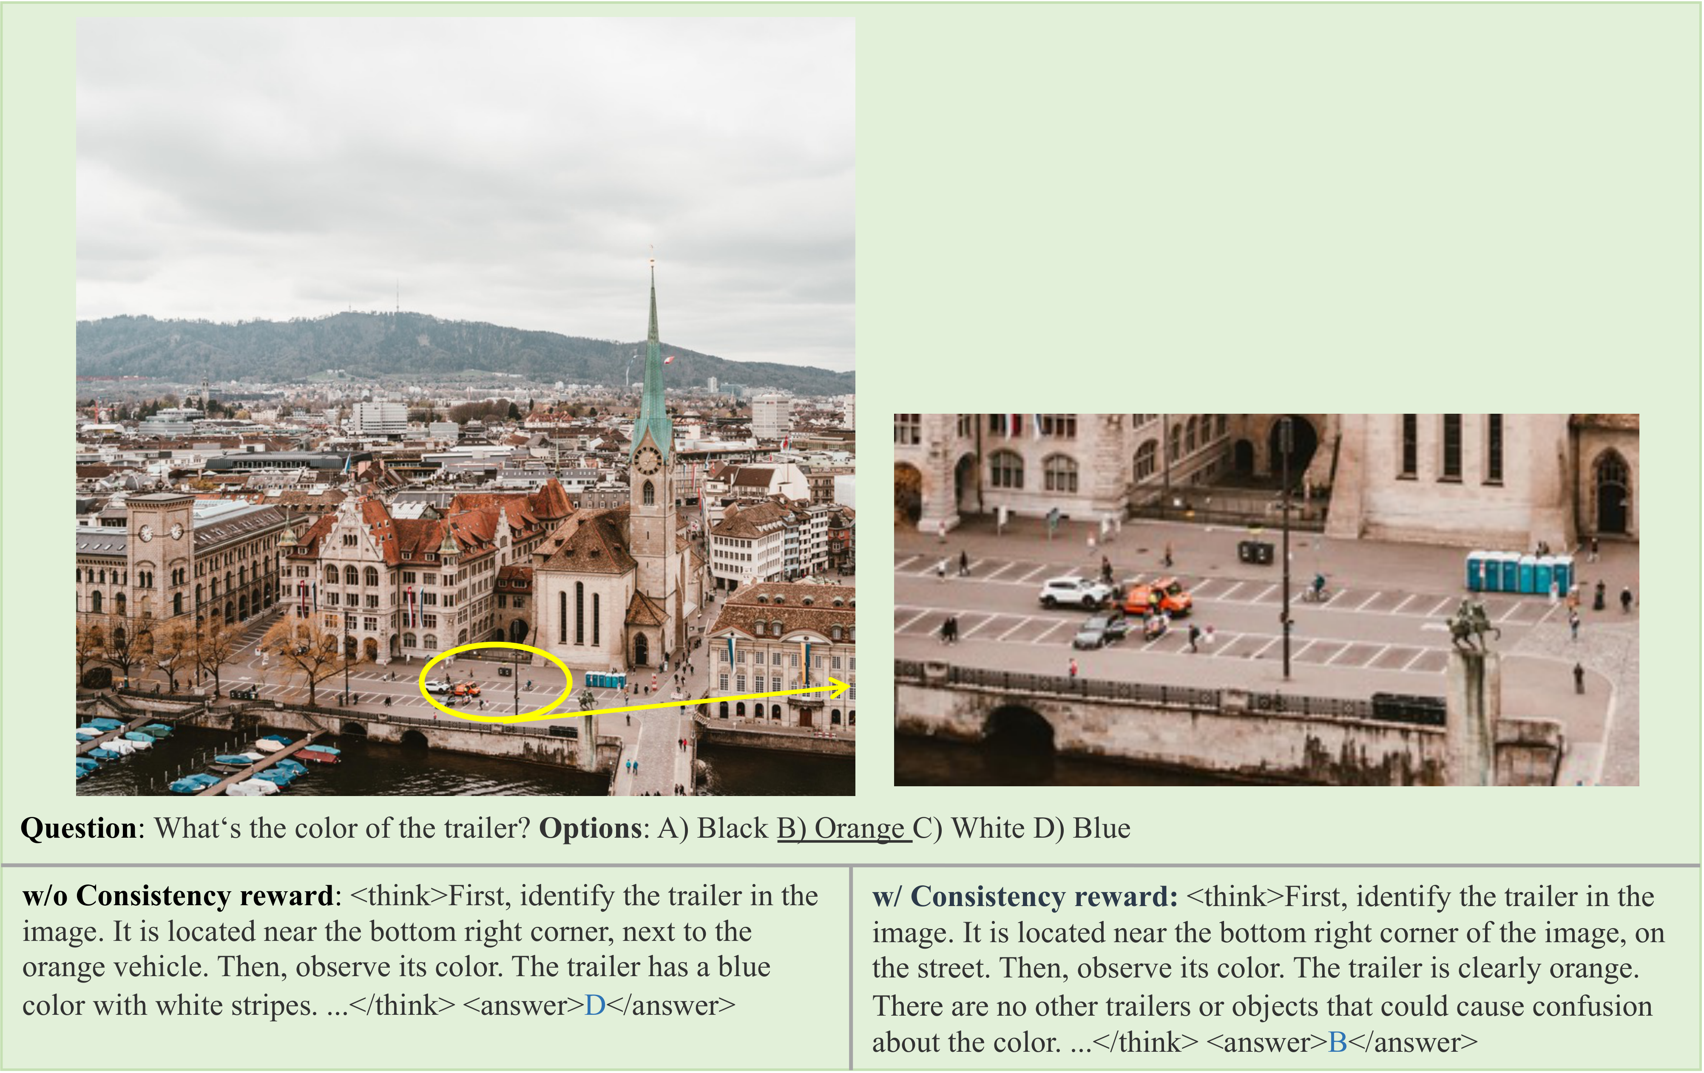
Qualitative results of the consistency reward
w/o consistency reward → wrong region, “blue” ✗ iVGR → finds the trailer, “orange” ✓
iVGR · ICML 2026
15

Slide 17
Takeaways
✓ Grounding at inference is unnecessary.
✓ Consistency reward aligns the dual streams.
✓ SOTA on fine-grained VQA, tool-compatible.
project page & code
iVGR · ICML 2026
16

