Slide 1



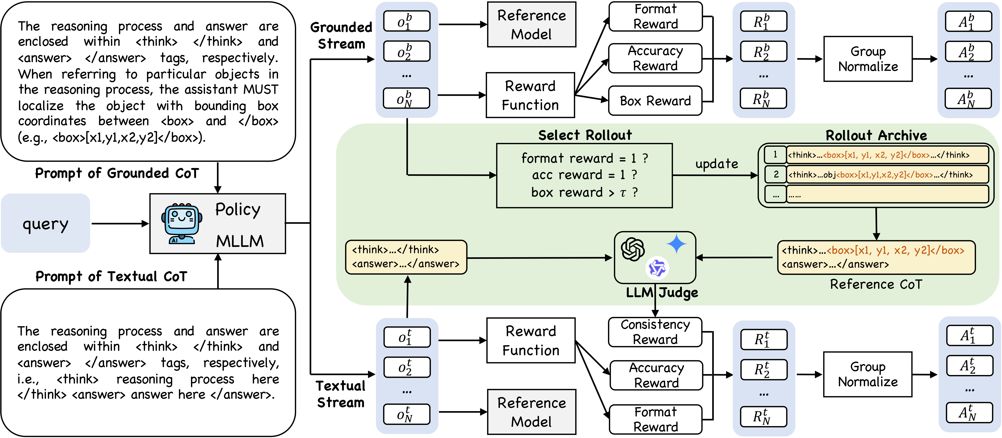
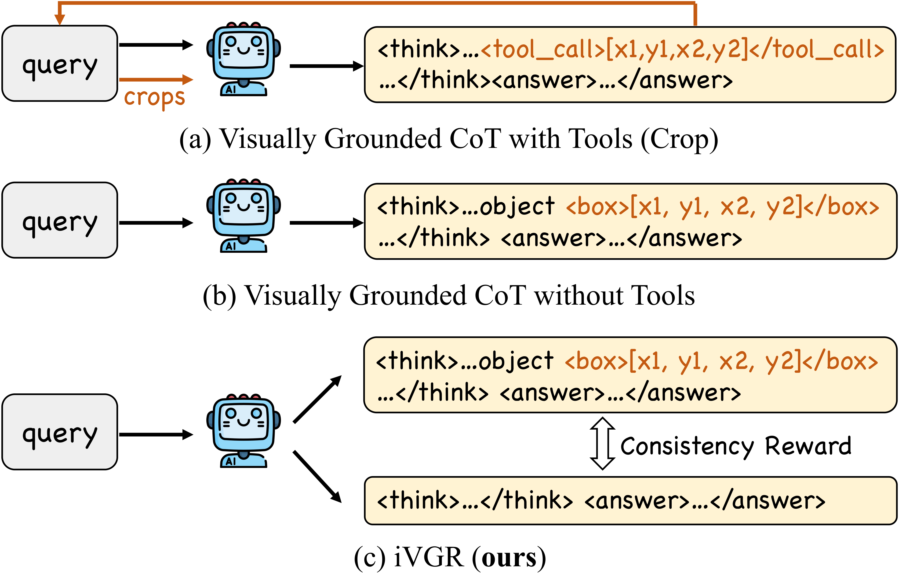
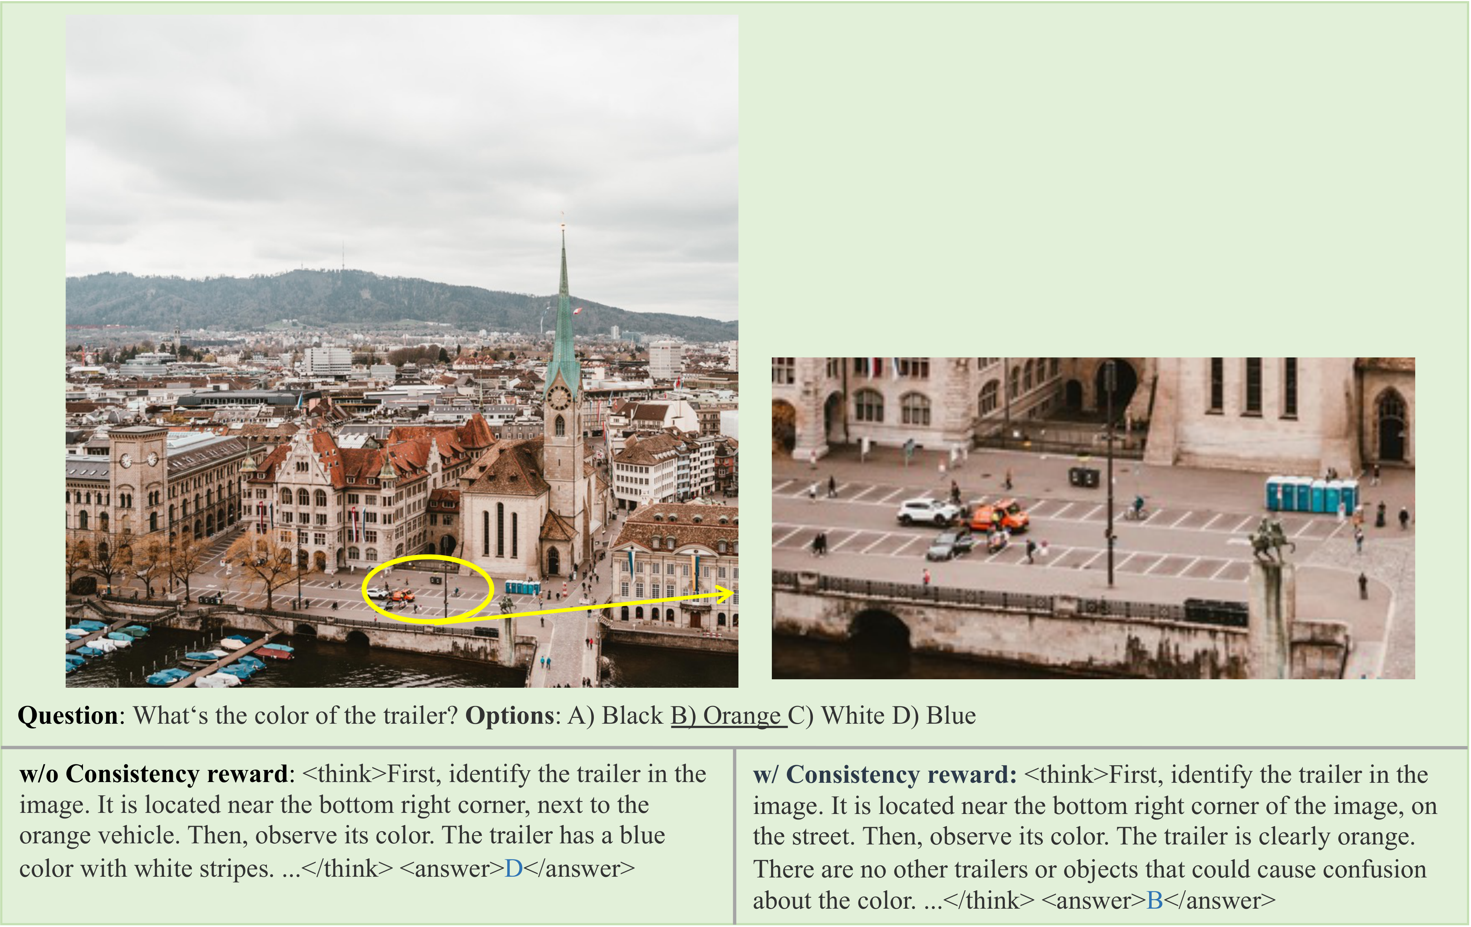
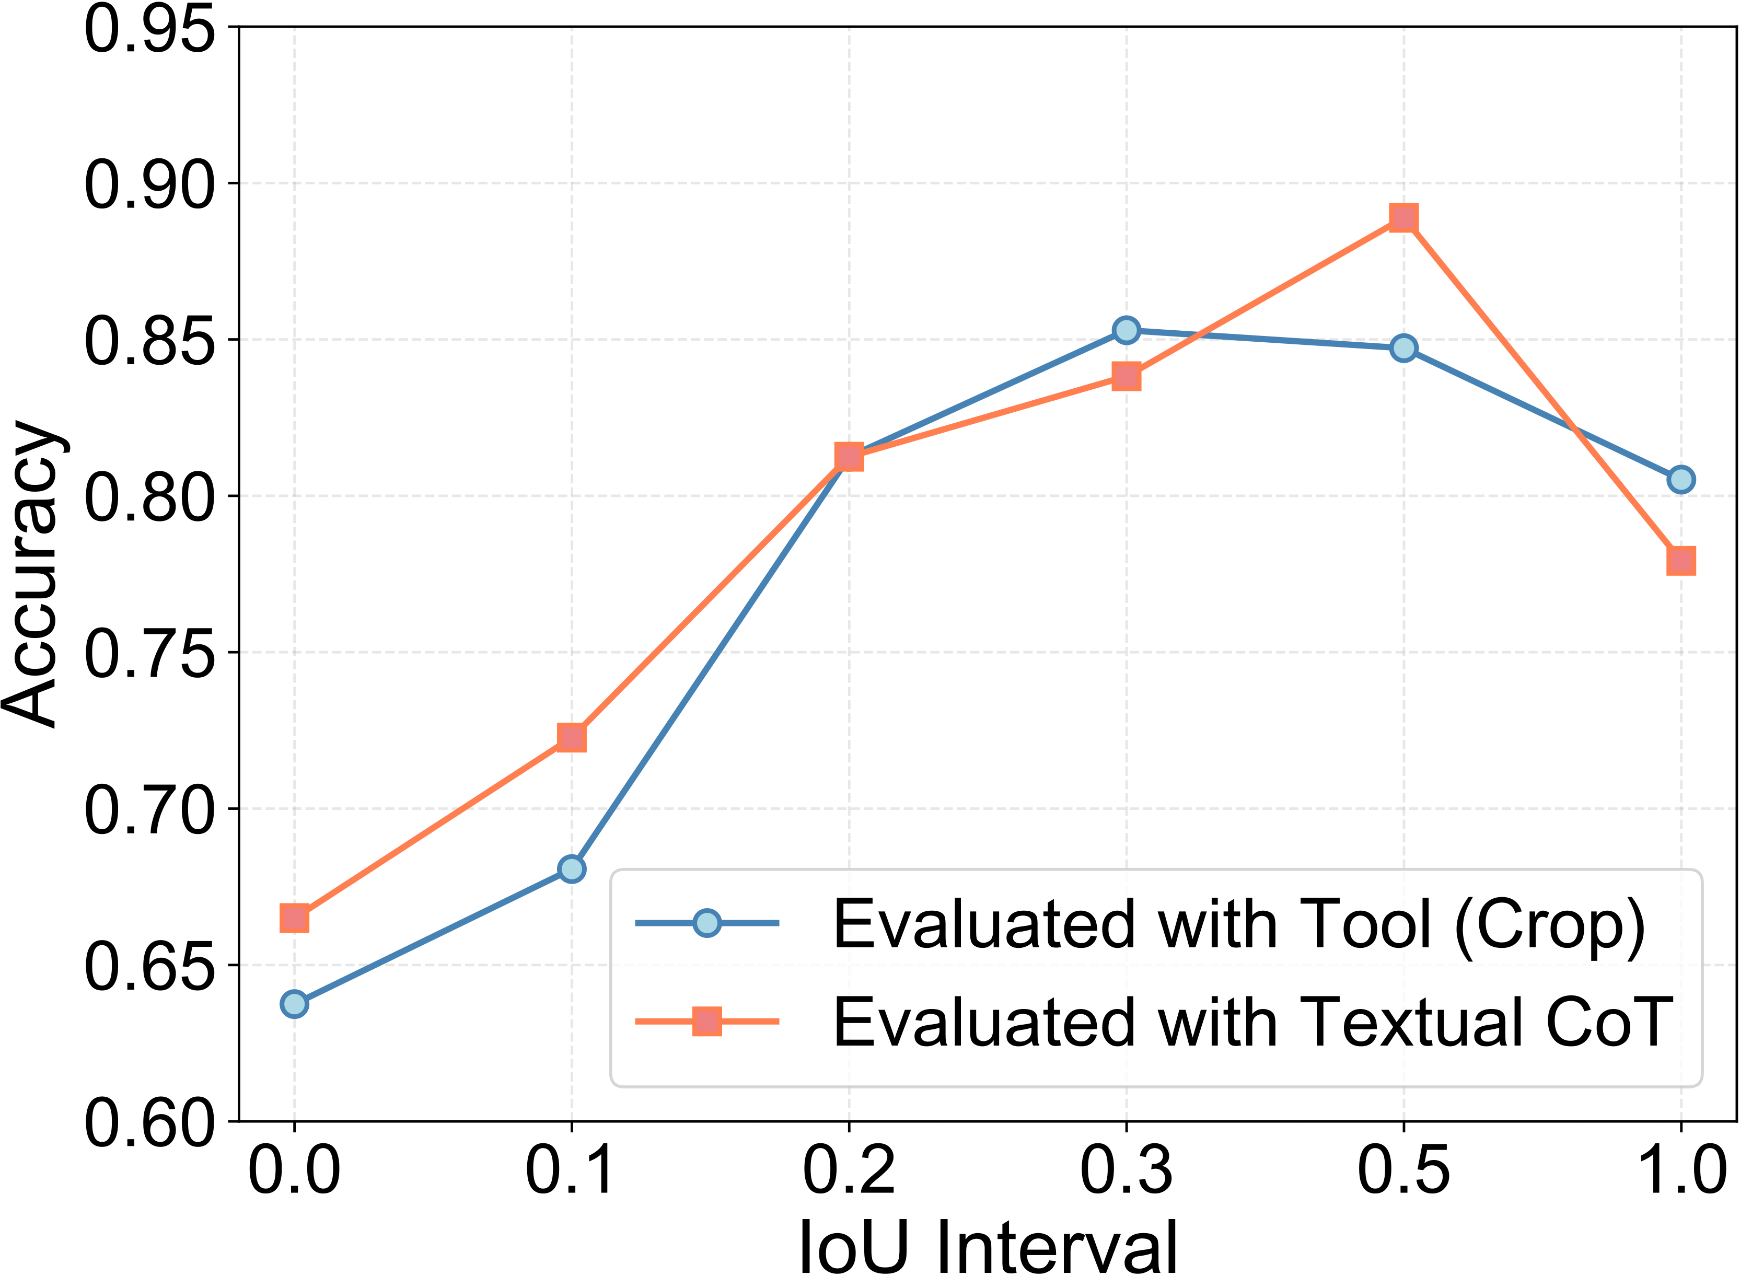
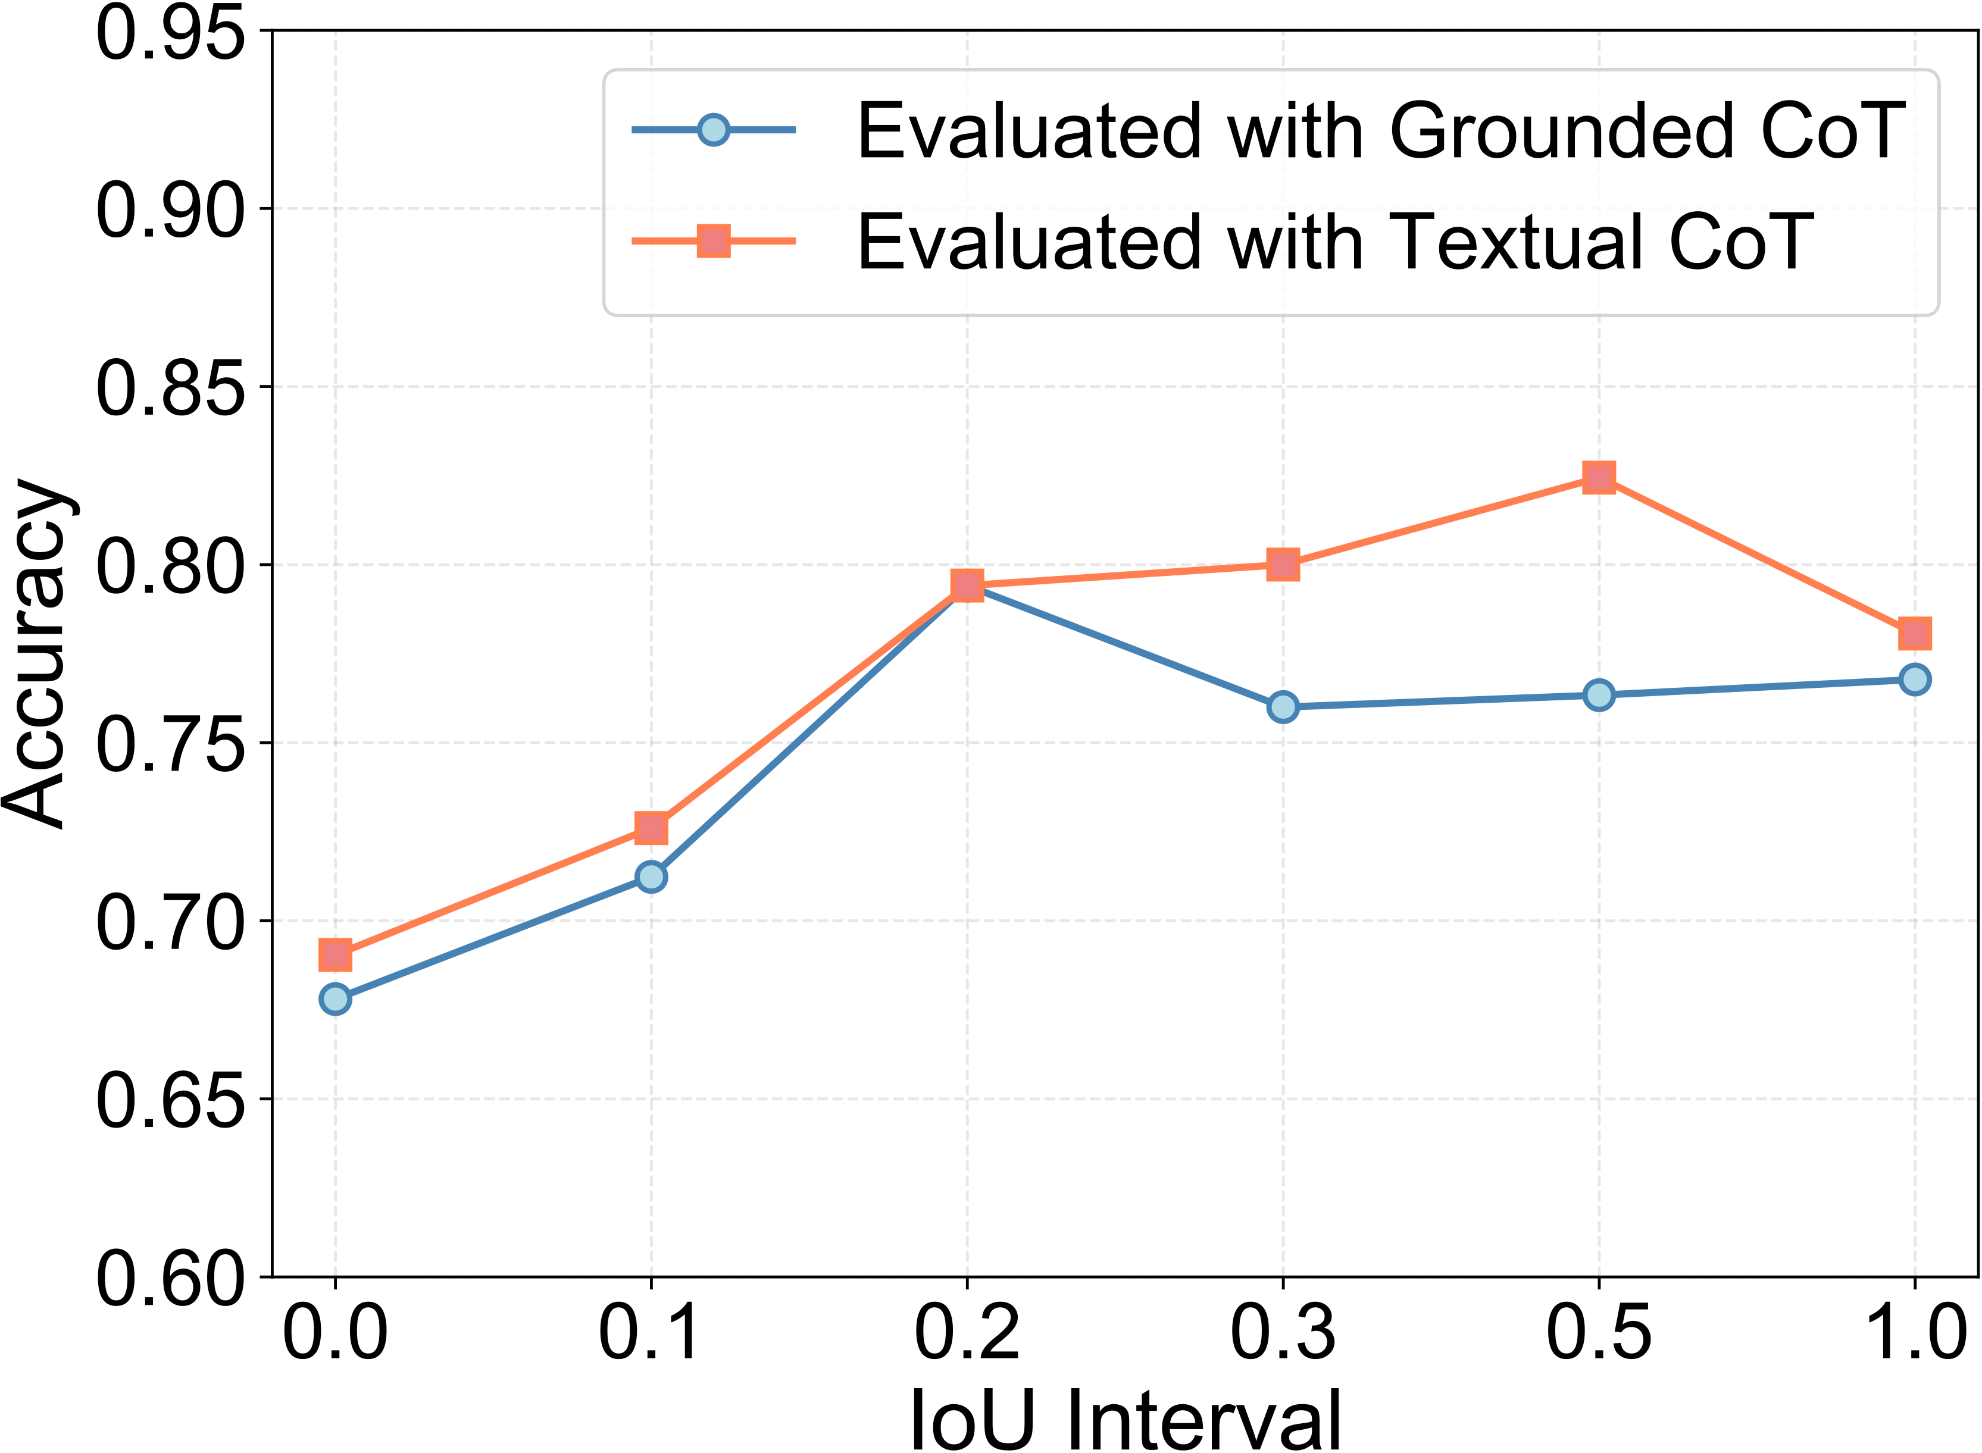

iVGR: Internalizing Visually Grounded Reasoning for MLLMs with Reinforcement Learning
Chang-Bin Zhang¹ Yujie Zhong² Qiang Zhang³ Kai Han^{1*}
¹ Visual AI Lab, The University of Hong Kong ² Independent Researcher ³ University of Science and Technology of China
Seoul, Korea · 2026
Background & Task
2
iVGR: Dual-Stream RL with a Consistency Reward
3
Results: SOTA Without Boxes
Challenges: MLLMs struggle with fine-grained visual reasoning (missing details and poor spatial focus).
Existing Paradigms:
“Think with images” (e.g., OpenAI o3, DeepEyes): Dynamically invoke crop tools.
“Think with visual primitives” (e.g., Deepseek, TreeVGR): Output explicit bounding boxes/points within CoT.
iVGR: a third paradigm, internalize visually grounded reasoning.
Fine-grained & general VQA (avg. of 8 benchmarks)
Model | Avg. | Δ
Gemini-3.1-Pro-Preview | 83.9 | –
GPT-5.4 | 83.1 | –
Qwen2.5-VL-7B (baseline) | 70.1 | –
Thyme-7B (ICLR’26) | 74.6 | +4.5
DeepEyes-7B (ICLR’26) | 74.1 | +4.0
TreeVGR-7B (ICLR’26) | 74.7 | +4.6
iVGR-7B (ours) | 76.6 | +6.5
Qwen3-VL-8B (baseline) | 76.2 | –
iVGR-8B (ours) | 80.6 | +4.4
Qwen3-VL-32B (baseline) | 79.6 | –
iVGR-32B (ours) | 82.9 | +3.3
1
Motivation: Grounding at Inference?
Three paradigms: (a) crop tools, (b) explicit boxes, (c) iVGR (ours).
Our finding
Each query rolls out in two streams; the textual stream is aligned to high-quality grounded references via the consistency reward.
Prompt off-the-shelf grounded-CoT models to reason in plain text — they beat their own grounded CoT, without any retraining.
Grounded stream
Tool-assisted test-time scaling
Also: chart & multidisciplinary +2.5 / +3.3 / +2.6 on 7B / 8B / 32B.
Localize every mentioned object: <box>[x1,y1,x2,y2]</box>
1
Generate grounded CoT once; extract all predicted boxes.
Effect of the consistency reward
Avg. of 8 VQA benchmarks | Grounded | Textual | Δ
DeepEyes-7B (crop-based) | 74.1 | 75.1 | +1.0
TreeVGR-7B (box-based) | 74.7 | 75.7 | +1.0
Format
+
Accuracy
+
Box IoU
2
Crop each box + a union crop (for keeping spatial context).
✓ Correct region
“The trailer is clearly orange”
✗ Wrong region
“The trailer has a blue color with white stripes”
3
Feed global image + crops back; answer with textual CoT.
Textual stream
Test-time scaling | V* | HR4K | HR8K | Avg.
iVGR-7B | 86.4 | 78.3 | 75.5 | 80.1
iVGR-7B + crops + union | 90.1 | 81.8 | 76.3 | 82.7
iVGR-8B | 90.1 | 82.0 | 80.1 | 84.1
iVGR-8B + crops + union | 93.2 | 84.3 | 79.3 | 85.6
Plain text reasoning — no coordinates; used at inference.
Format
+
Accuracy
+
Consistency
novel — transfers grounding
Consistency reward
1. Reference selection:
valid format · correct answer · R_{box} > τ = 0.3.
2. Rollout archive:
persist the best grounded CoT per query (hit rate → ~50%).
3. LLM judge (Qwen2.5-72B):
same visual content as the reference?
What matters? (ablation study, avg. of 5 benchmarks)
Variant (all RL from same cold-start) | Avg.
Cold-start SFT | 67.1
GRPO, textual stream only | 69.1
GRPO, grounded stream only | 71.1
Dual-stream, no consistency reward | 71.0
+ consistency reward | 71.5
+ rollout archive (full iVGR) | 72.4
Accuracy vs. IoU of the grounded CoT (HR8K).
• DeepEyes (crops): wins only when crops are accurate (IoU > 0.5).
• TreeVGR (boxes): grounded CoT loses across all IoU intervals.
w/o consistency reward → wrong region, “blue” ✗ ;
iVGR → finds the trailer, “orange” ✓
1.0
identical visual content
0.7
omits OR adds details
Takeaways
Key insight
0.3
0.0
✓ Grounding at inference is unnecessary.
✓ A consistency reward aligns the dual streams.
✓ SOTA on fine-grained VQA, 7B–32B, tool-compatible.
Localization can be internalized into textual reasoning: mandatory boxes/crops at inference interfere with answering.
→ Internalize in training; reason in pure text at inference.
omits AND adds details
contradicts reference
• Consistency reward + archive deliver the gains
Learn to look at the right place, without coordinates.
project page & code

